Slide 1

Why Developers Should Love PowerShell
Kurt Kroeker
EnergyCAP, Inc.
Notes:
Introduce Myself
About This Talk/Agenda
Talking
What is PowerShell?
Kurt's PowerShell Background
Why should YOU care about PowerShell?
Demos
Introduction to PowerShell console and scripting basics
Tips working with PowerShell
PowerShell Gotchas
DISCLAIMER #1: I want to reiterate that this is a beginner thru intermediate entry into the world of PowerShell, so if you’re already an experienced PS user, you might not get much out of my talk.
Show of Hands: How many already using PowerShell cmdlets on a daily basis? Written your own functions?
DISCLAIMER #2: I have a lot to cover, so if you’re following along on your computer and have an issue with something you saw me do, please write down your questions for the end of the session and I’ll hang around afterward for a little bit, too.

Slide 2


Kurt Kroeker Sr. Integration Software Developer EnergyCAP, LLC
Email: kurt.kroeker@energycap.com
Notes:
sxa

Slide 3

PowerShell and Me
Shortcuts to often-used directories
Library of personalized functions
Testing scripts using Pester
Build scripts
Automate manual, error-prone tasks

Slide 4


When all you have is a hammer…

Slide 5
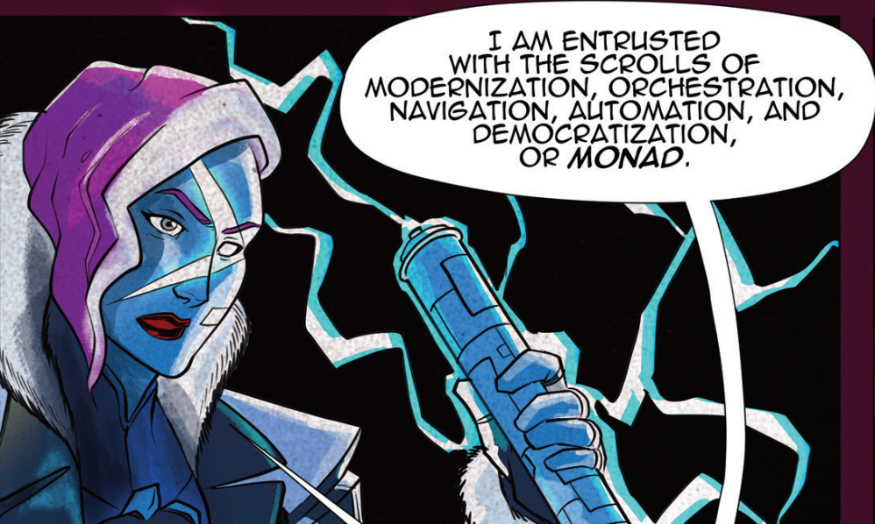

Slide 6

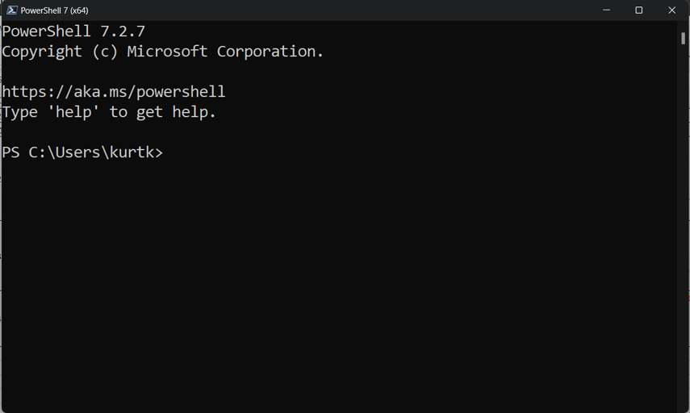
What is PowerShell?

Slide 7

PowerShell and You!
Powerful
Everywhere
Familiar

Slide 8
PowerShell Concepts
PowerShell Console
Commandlets + Parameters
Aliases
Variables
Pipelines

Slide 9
PowerShell Script File Concepts
Script files
Functions
Operators
Error Handling
Param()
VS Code & ISE

Slide 10
PowerShell Working Tips
Get-Help, -Command, -Member
The tab key
Up/Down arrows, Ctrl + R, Ctrl + C
Your PowerShell Profile
Web API Interactions

Slide 11
PowerShell Gotchas
Is it an array?
Calling programs with arguments
Working with strings

Slide 12
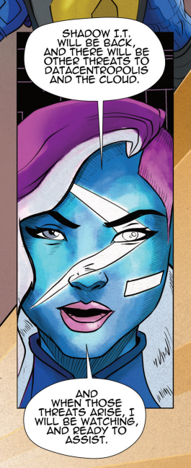
Conclusion
We covered…
What is PowerShell?
PowerShell is
Powerful
Everywhere
Familiar
PowerShell Console & Scripting Basics
PowerShell Working Tips & Gotchas
Any Questions?

Slide 13

PowerShell Resources
PowerShell Core in GitHub
https://github.com/PowerShell/PowerShell
PS Gallery
https://www.powershellgallery.com
Unit Testing PS with Pester
https://pester.dev/
PowerShell Hero Stuff
https://learn.microsoft.com/en-us/powershell/scripting/community/digital-art?view=powershell-7.2

Slide 14
Kurt Kroeker Sr. Integration Software Developer EnergyCAP, LLC
Email: kurt.kroeker@energycap.com
Download PowerPoint and demo files here:
Todo - LINK
Notes:
sxa

Slide 15

Go forth and conquer!

Slide 16
Subjects Not Covered
PSCustomObject creation
Add-Type to use DLLs
“Splatting” arguments
ExecutionPolicy

